Slide 1
CIS 5525: Neural Computation
Week II: Feedforward Neural Networks
Instructor: Kai Zhang
CIS @ Temple University, Spring 2020

Slide 2
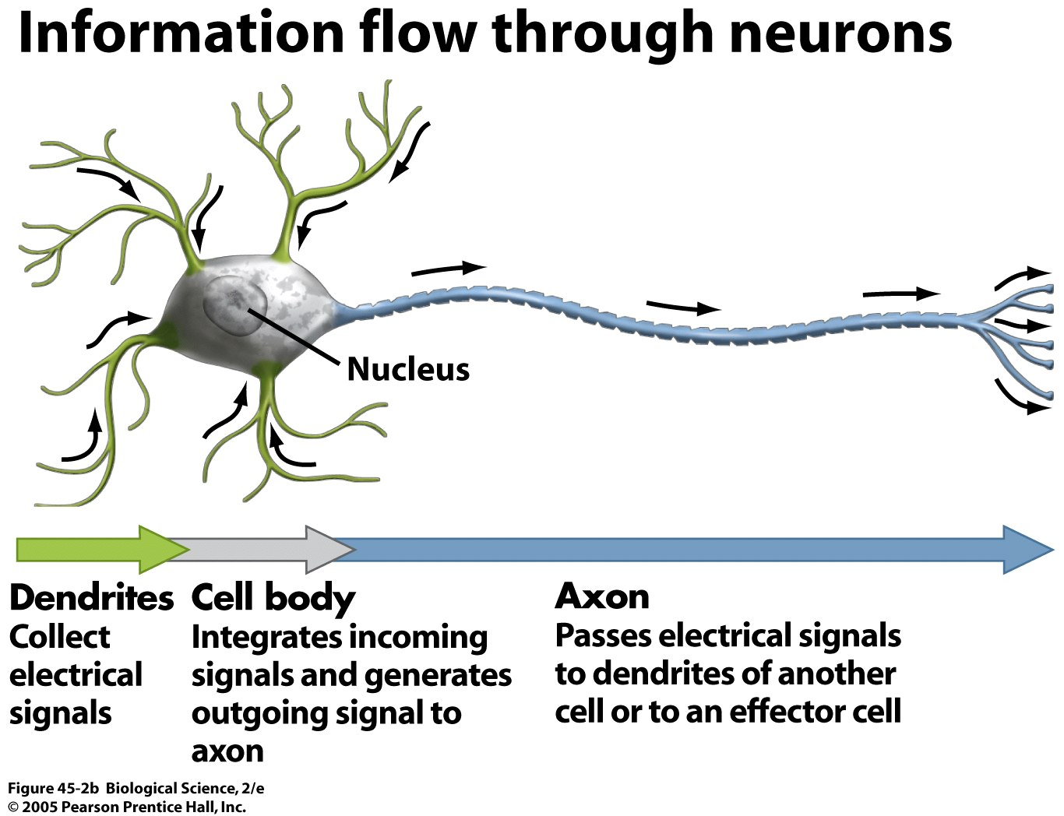
Information Flow in Neurons

Slide 3
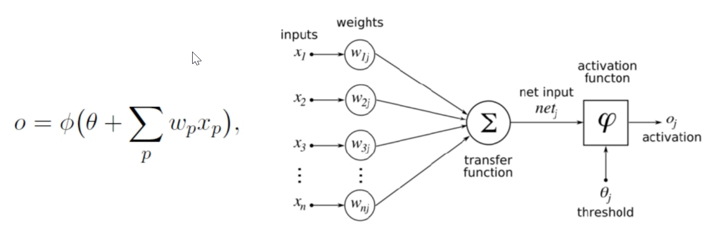

Perceptron
Basic model for the perception learning algorithm (PLA,1950’s)
Assumes data are linearly separable
Sign function as the activation, decision function $O=sign(W^{′}x+θ)$
adder
The perceptron: a probabilistic model for information storage and organization in the brain, Frank Rosenblatt, Psychological Review, 1958

Slide 4
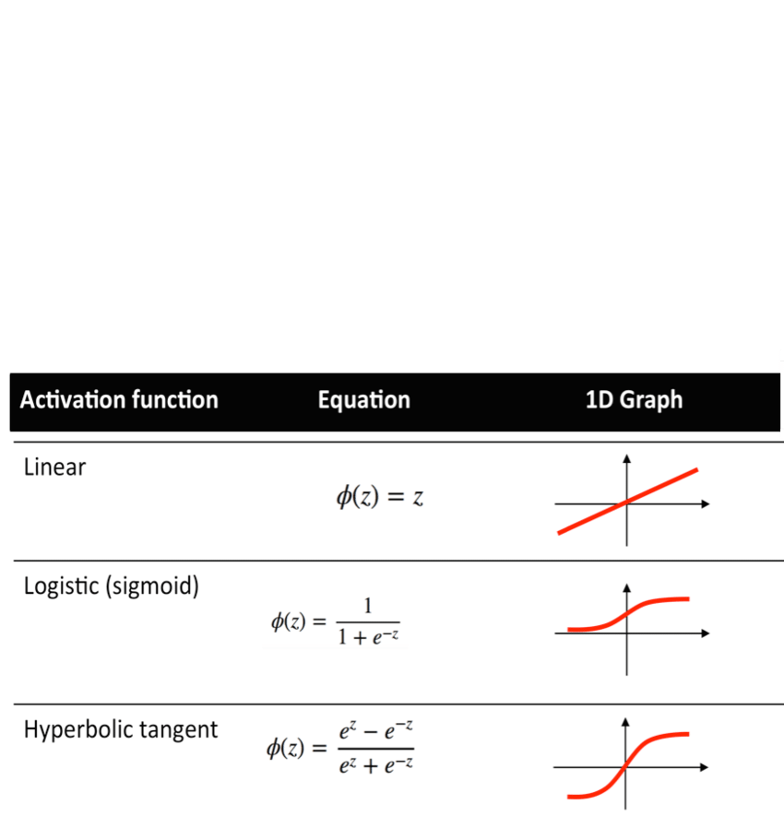
Activation Functions
Threshold (step), sigmoid, tanh, softplus, rectifier, RELU, etc.

Slide 5
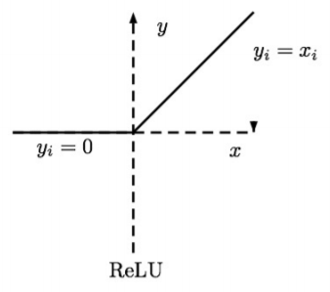
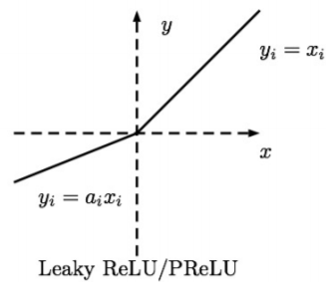
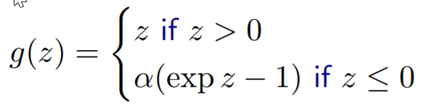
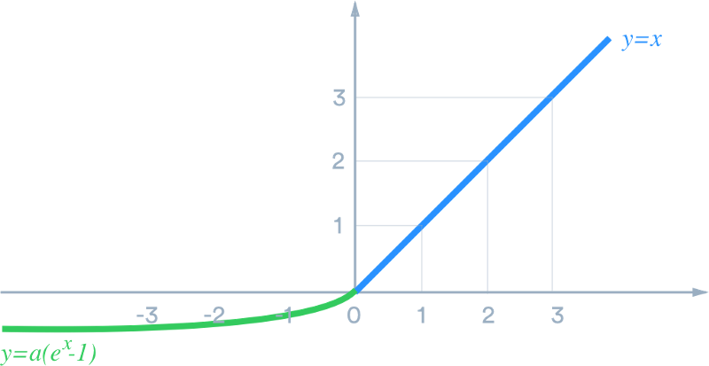
More activation function in deep learning
Leaky RELU
(Maas et al., 2013) Fix ai to a small value
Parametric ReLU:
(He et al., 2015) Learn alpha_i
ELU (exponential linear unit)
Clevert et al. ”Fast and Accurate Deep Network Learning
by Exponential Linear Units (ELUs)”

Slide 6

Decision Boundary of a Perceptron
x₂
x₂
x₃
w₁x₁ + w₂x₂ + w₃x₃ + w₀ = 0
w₁x₁ + w₂x₂ + w₀ = 0
x₁
x₁
Weights are the coefficients of hyperplane
w^{T}x is the (signed) distance of point x to hyperplane w
Example: http://mathinsight.org/distance_point_plane

Slide 7
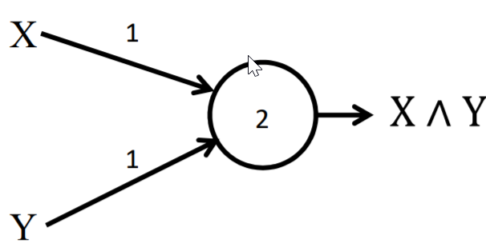
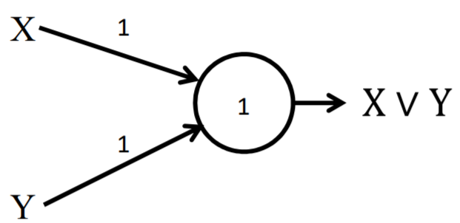


Simple Boolean Unit
AND gate
OR gate
$$O= step\left(X∗1+Y∗1−2\right)$$
$$O= step\left(X∗1+Y∗1−1\right)$$

Slide 8
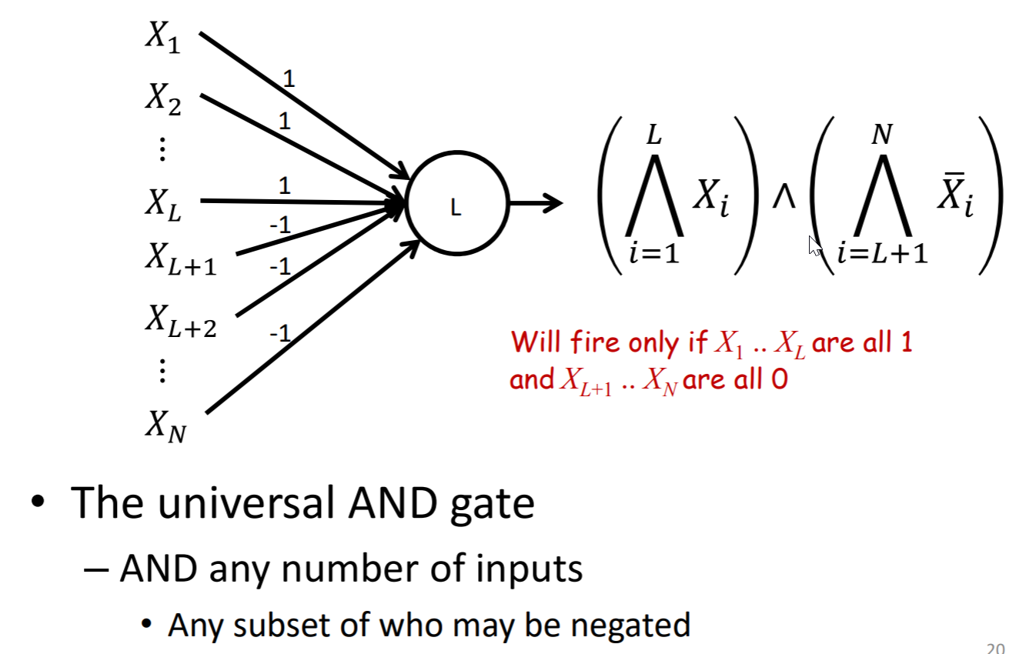
Combined Boolean Units

Slide 9
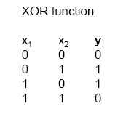
Limitation of single-layer perceptron
What a perceptron can do
mimic any Boolean function
What it cannot

Slide 10
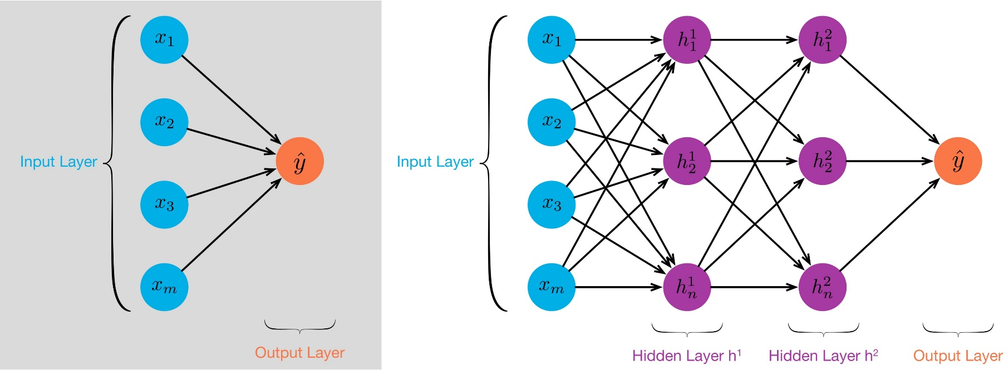
Multiple layer perceptron (MLP)
The MLP is a Universal Approximator for the entire class of functions (maps) it represents
Theoretical result [Cybenko, 1989]: 2-layer net with linear output can approximate any continuous function over compact domain to arbitrary accuracy (given enough hidden units!)

Slide 11
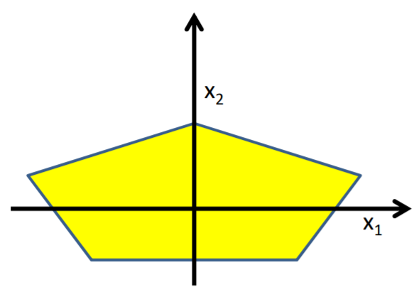
Complicated decision boundaries by MLP
Build a network of units with a single output that fires if the input is in the coloured area

Slide 12
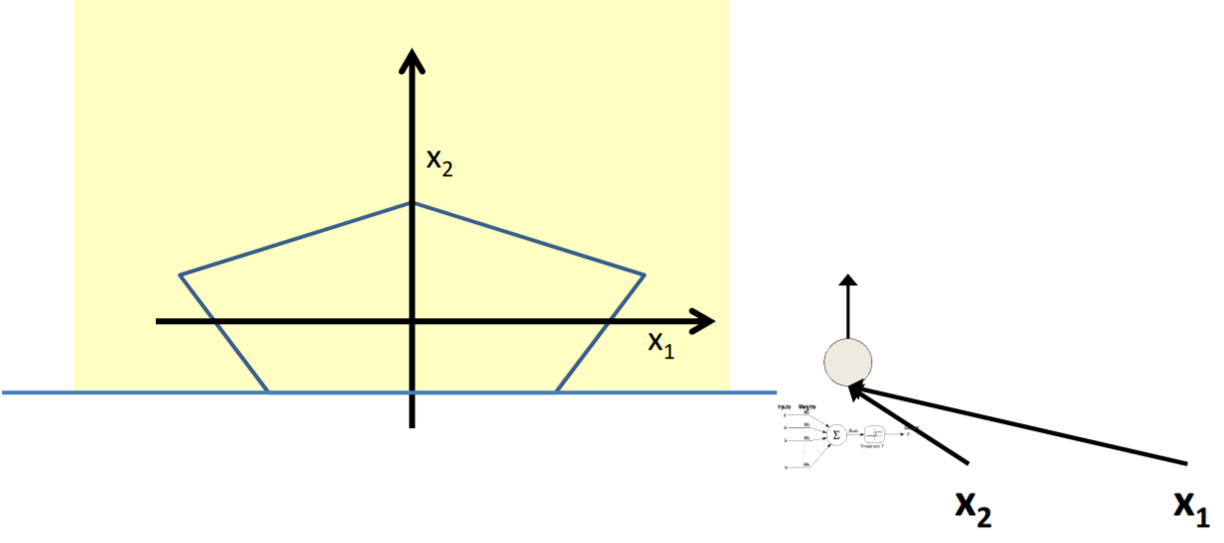
Complicated decision boundaries by MLP

Slide 13
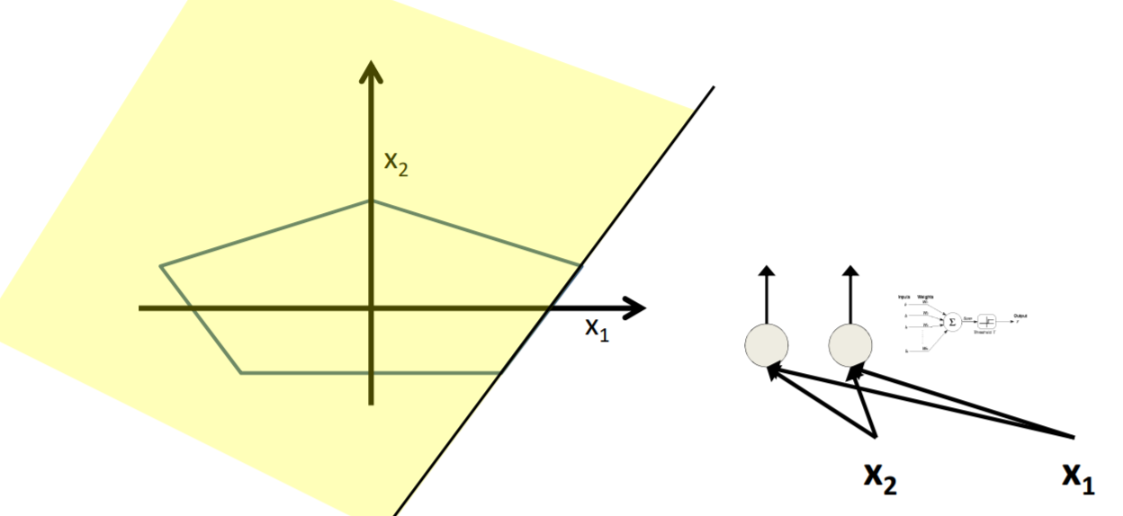
Complicated decision boundaries by MLP

Slide 14
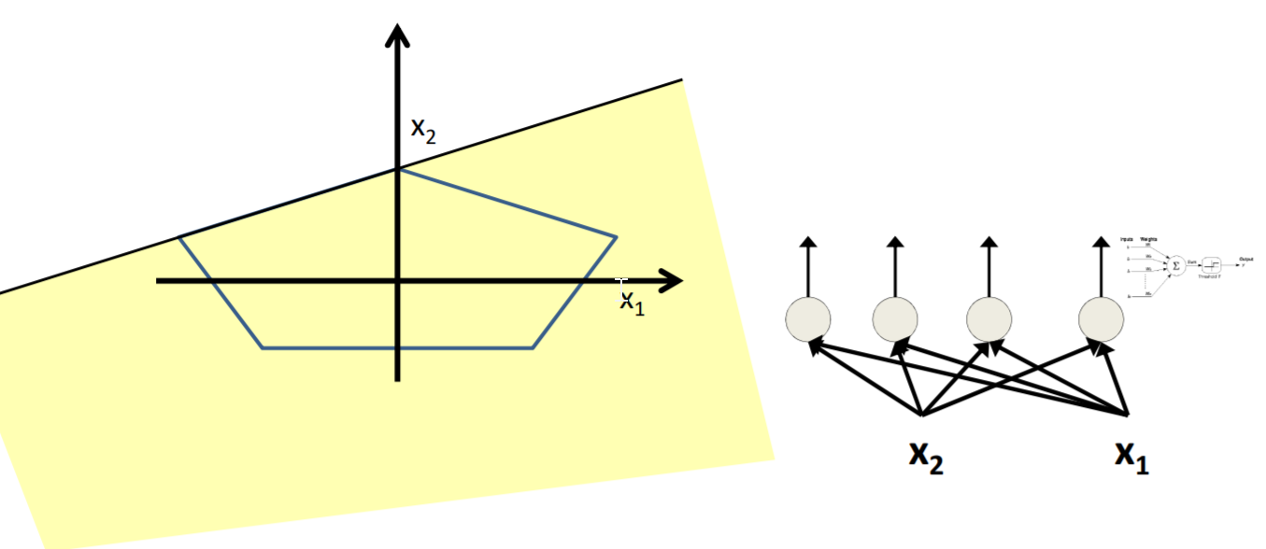
Complicated decision boundaries by MLP

Slide 15
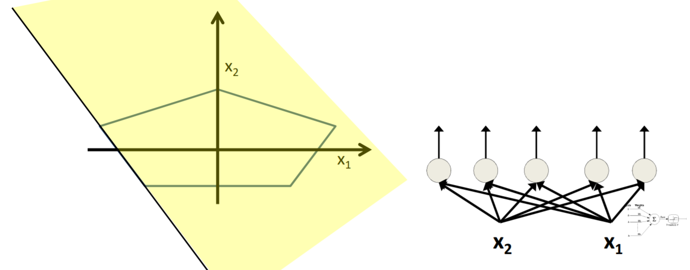
Complicated decision boundaries by MLP

Slide 16
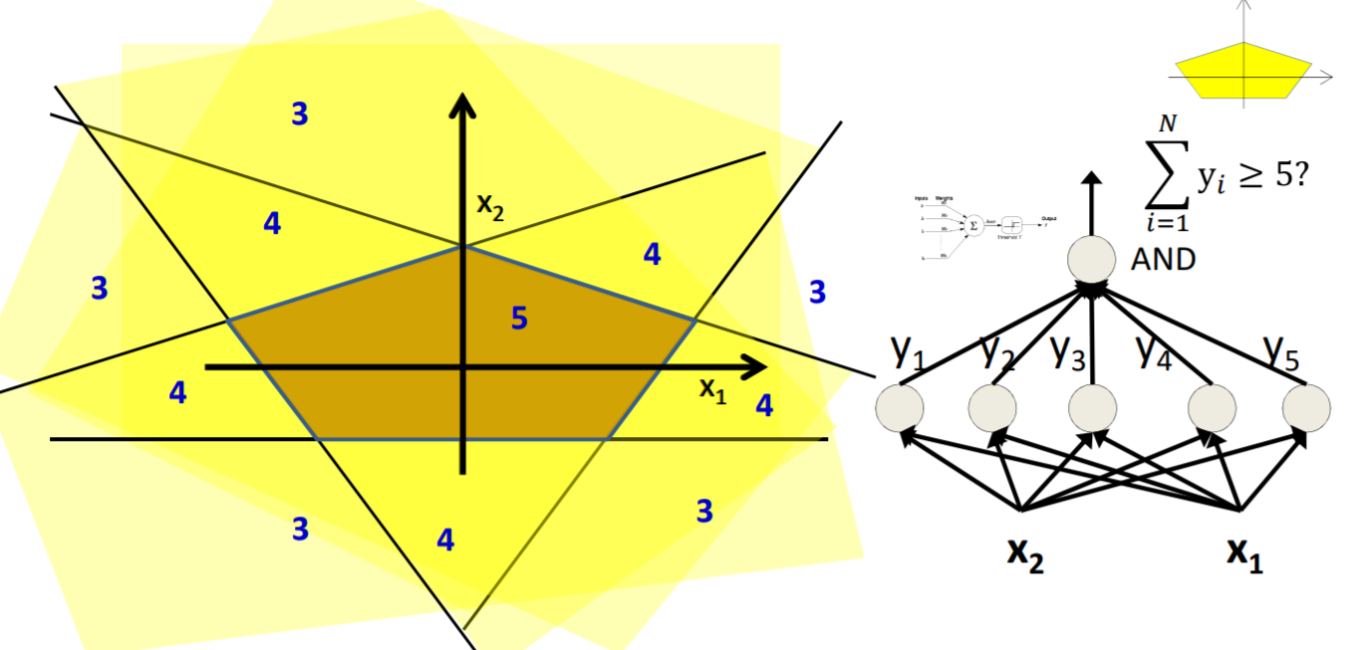
Complicated decision boundaries by MLP

Slide 17
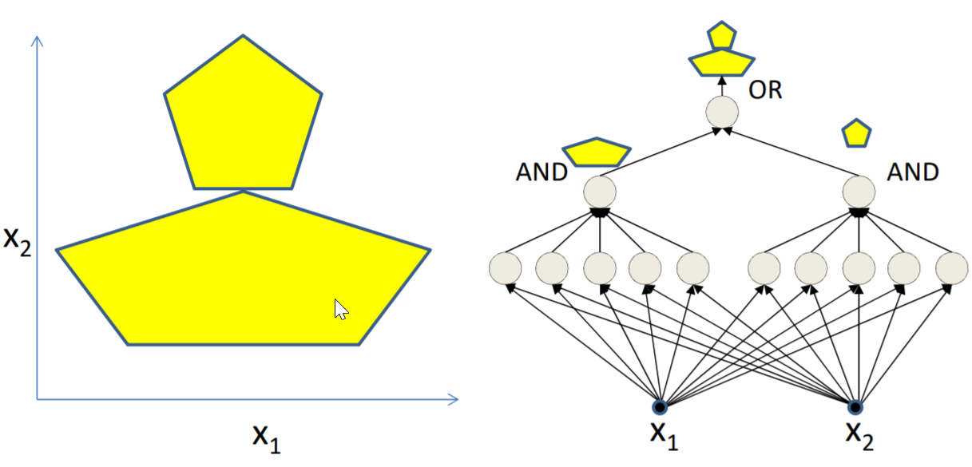
Complicated decision boundaries by MLP

Slide 18
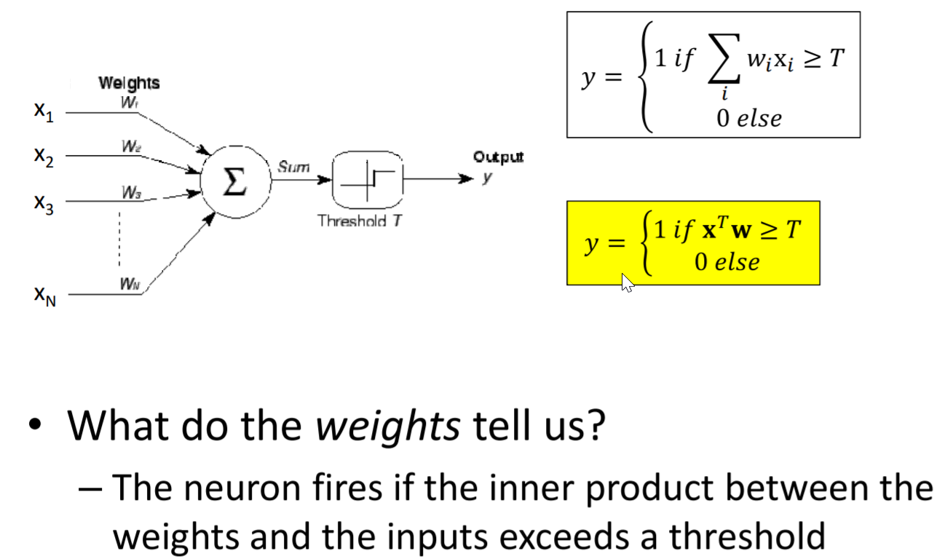
Continuous Input Scenarios

Slide 19
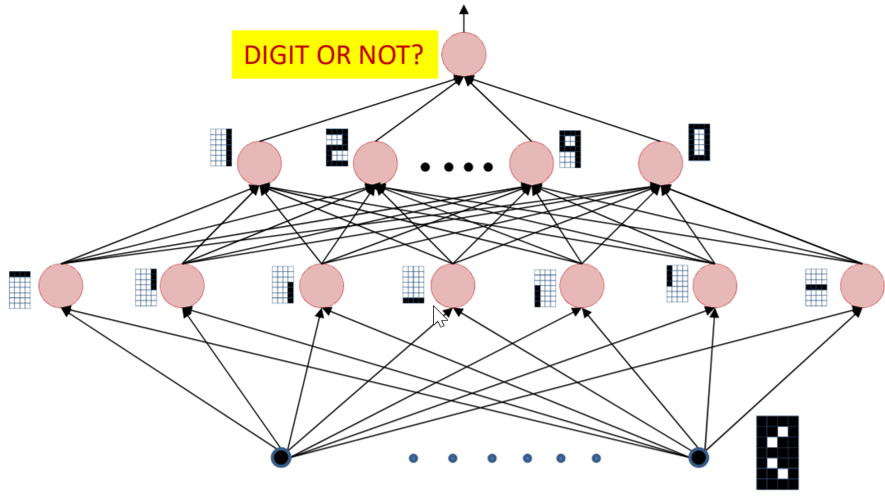
Cascaded Feature Detectors
The input layer comprises “feature detectors”
Detect if certain patterns have occurred in the input
The network is a Boolean function over the feature detectors
The network is a Boolean function over the feature detectors

Slide 20
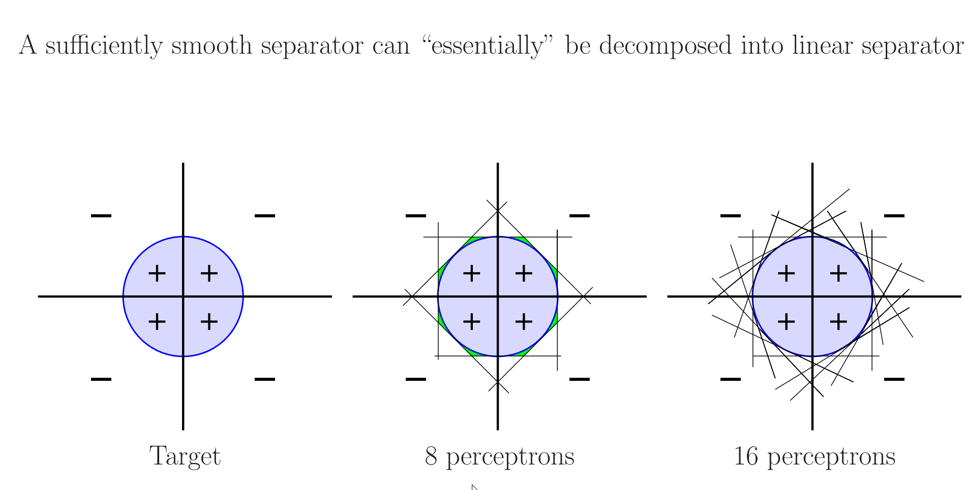
Universal Approximation
A three-layer perceptron (with one hidden unit) theoretically can approximate any decision function.

Slide 21
Weights of Hidden Units
What do the learned weights mean?
The weights connecting hidden layer to output layer form a linear discriminant
The weights connecting input layer to hidden layer represent a mapping from the input feature space to a latent feature space
For each hidden unit, the weights from input layer describe the input pattern that leads to the maximum activation of that node

Slide 22
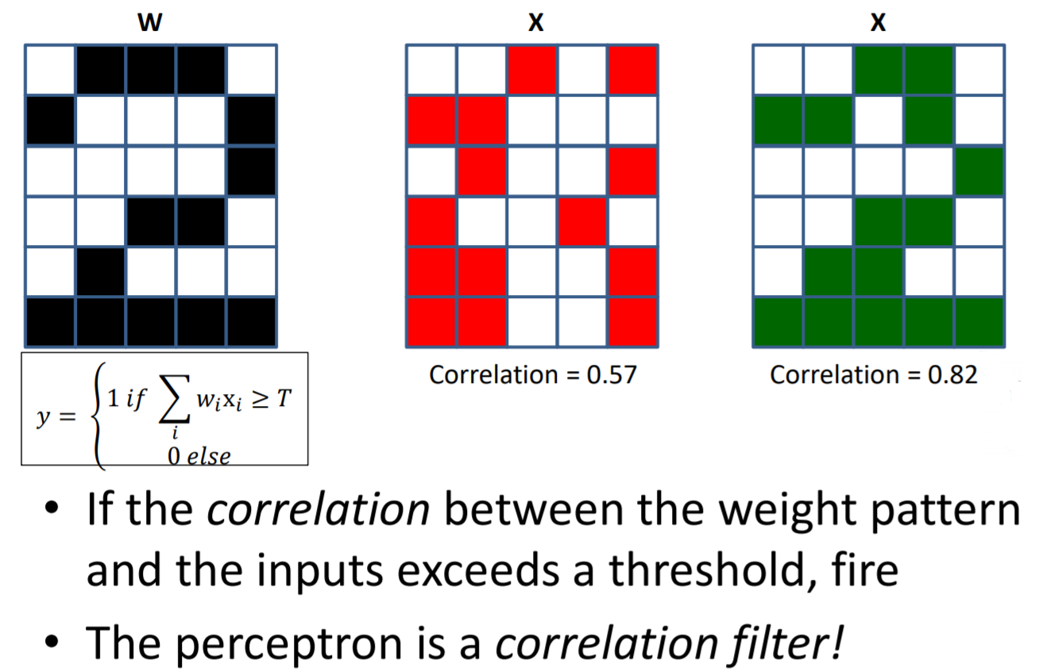
Weights as templates

Slide 23

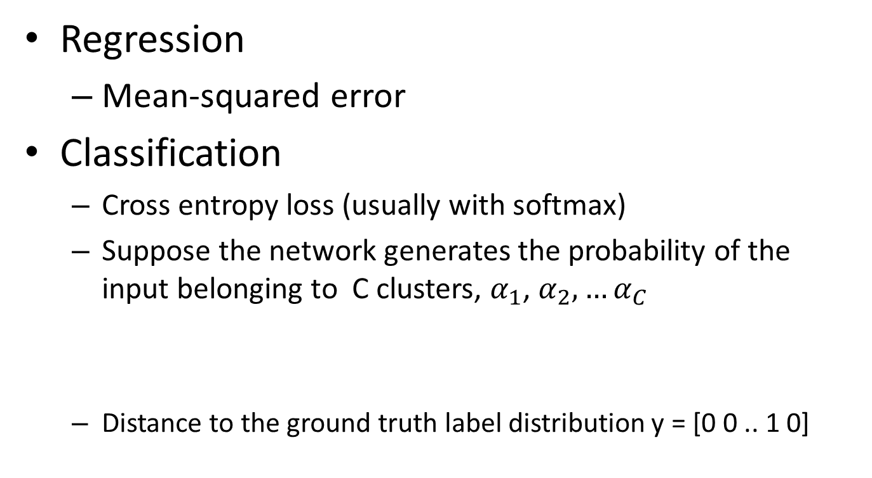

Loss or Error functions
Regression
Mean-squared error
Classification
Cross entropy loss (usually with softmax)
Suppose the network generates the probability of the input belonging to C clusters, $α_{1}$, $α_{2},…α_{C}$
Distance to the ground truth label distribution y = [0 0 .. 1 0]
$$cross entropy=y_{i}log⁡(p_{i})$$

Slide 24
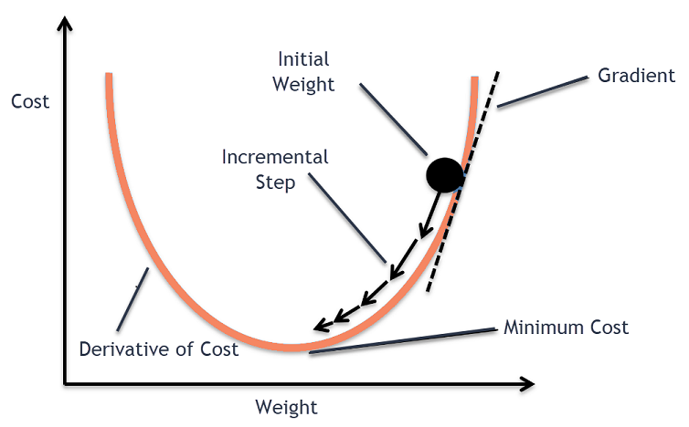
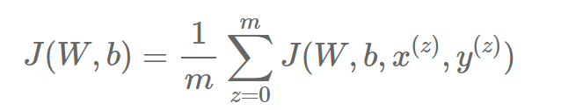

Optimization
Gradient Descent: a first-order iterative optimization algorithm for finding the minimum of a function
Batch Gradient Descent
all the training data is taken into consideration to take a single step.
We take the average of the gradients of all the training examples and then use that mean gradient to update our parameters. So that’s just one step of gradient descent in one epoch.
Can lead to very smooth update, but can get trapped easily into local optima

Slide 25
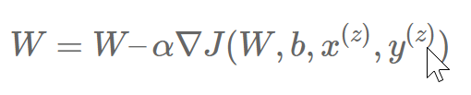
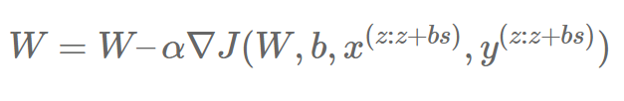
Stochastic Gradient Descent
Randomly choose one sample point at a time to compute gradient
Can be fluctuating a lot due to random nature
Very efficient computationally
Mini-batch Gradient Descent
a trade-off between stochastic gradient descent and batch gradient descent.
the cost function (and therefore gradient) is averaged over a small number of samples, from around 10-500.
Surprisingly, it also serves as a ``noisy perturbation’’ to the system, brining the benefit of jumping out of local optima
Escaping From Saddle Points-Online Stochastic Gradient for Tensor Decomposition
Lecun Yan: Training with large minibatches is bad for your health. More importantly, it's bad for your test error.
Still, small batch leads to instability, which requires more careful choice of the learning rate

Slide 26
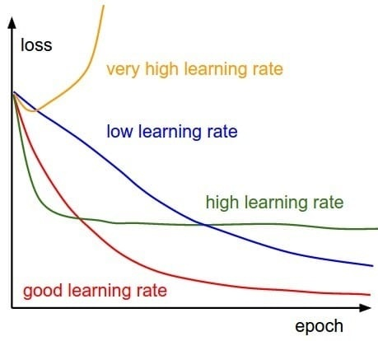
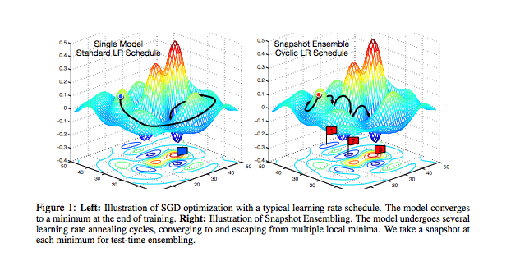
Learning Rate Selection
Many choices
Step decay
Cyclical rate
Triangle
Cosine
Annealing
Stanford CS231n: Annealing the learning rate
Cyclical Learning Rates for Training Neural Networks
https://ruder.io/deep-learning-optimization-2017/
Snapshot ensembles

Slide 27
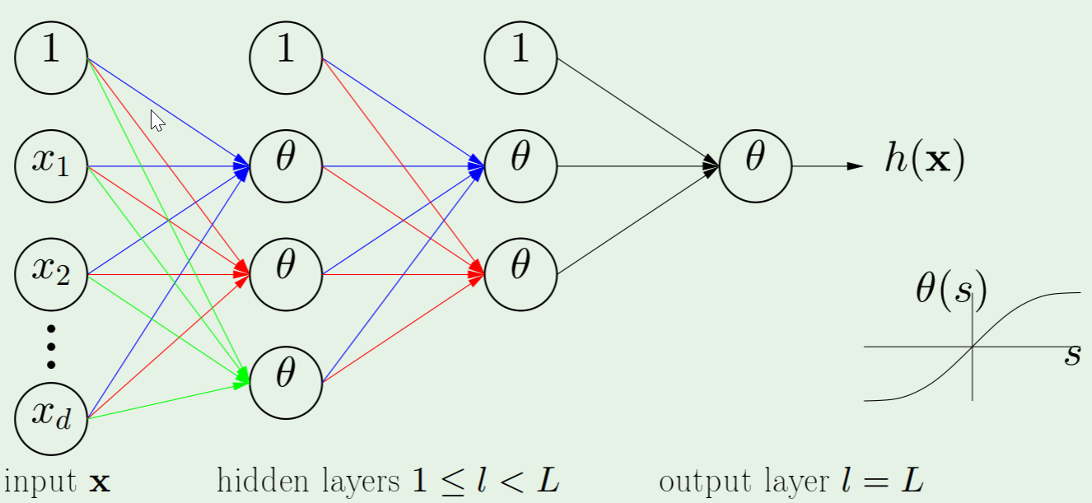
Backpropagation

Slide 28
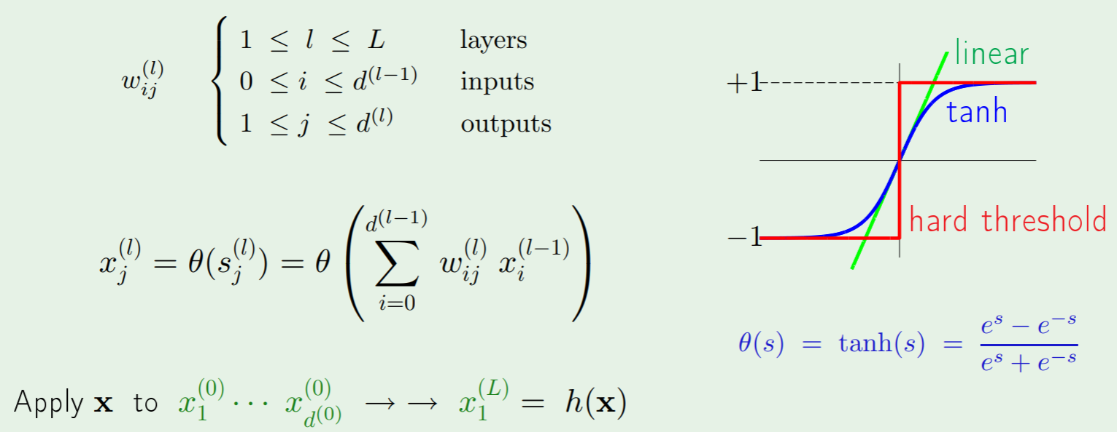
Backpropagation

Slide 29
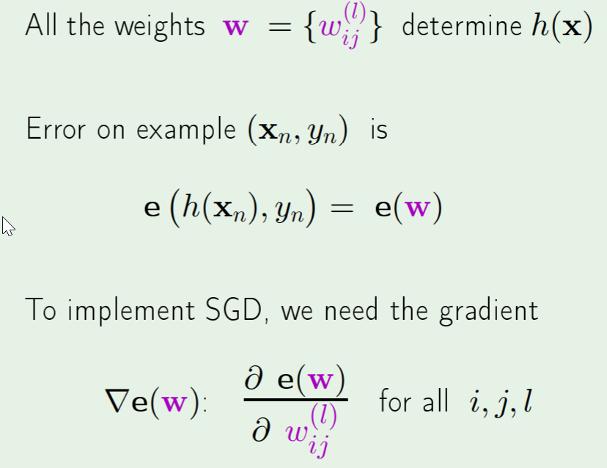
Backpropagation
Apply gradient descent (or SGD)

Slide 30
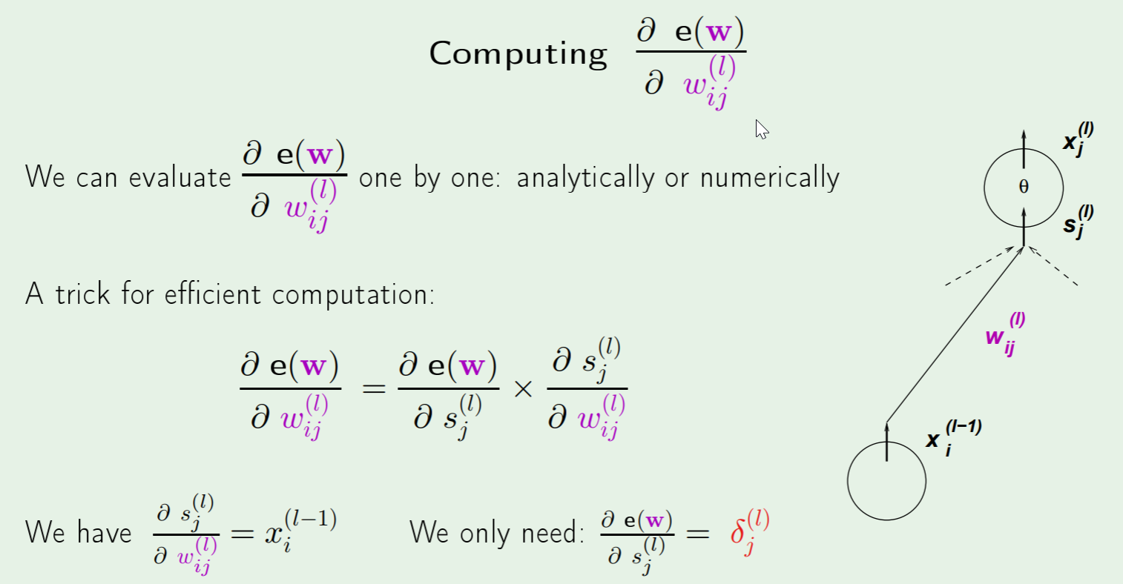
Backpropagation

Slide 31
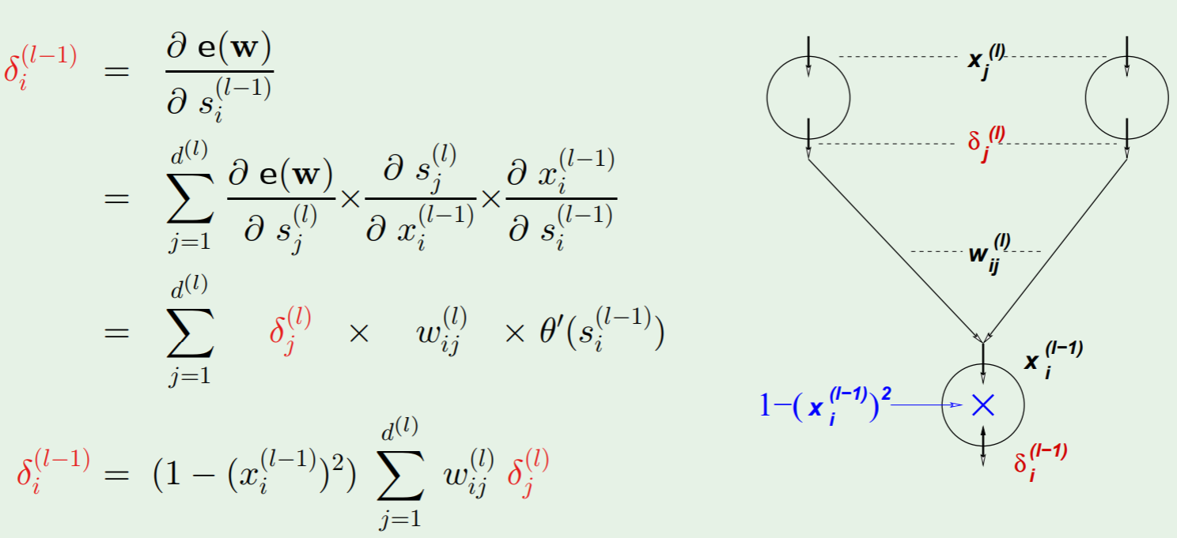
Backpropagation

Slide 32
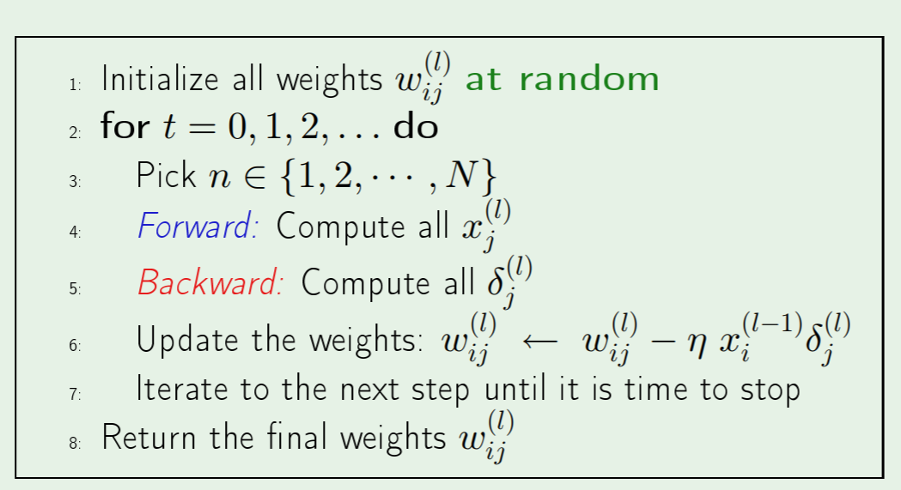
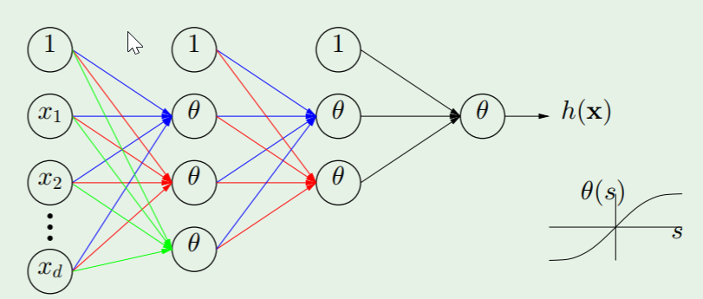
Backpropagation

Slide 33
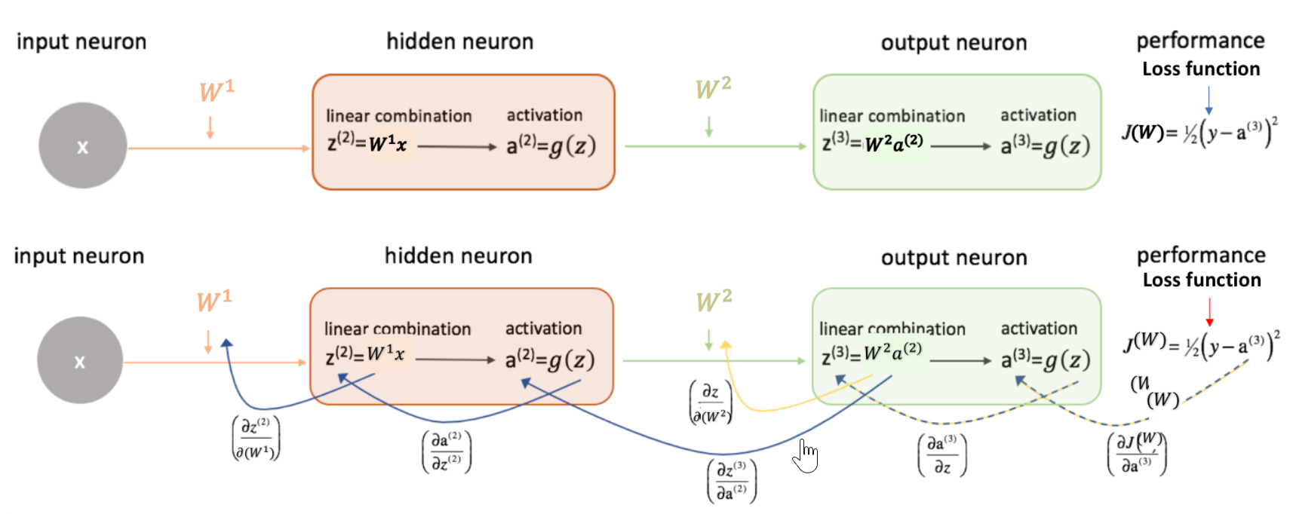
Practical Considerations
Weight Initialization
Setting everything to zero is a bad idea (randomization needed)
A too-large initialization: exploding gradients, saturation
A too-small initialization: vanishing gradients, nonlinearity disappears
For each activation layer: zero mean; similar standard deviations
Understanding the difficulty of training deep feedforward neural networks

Slide 34
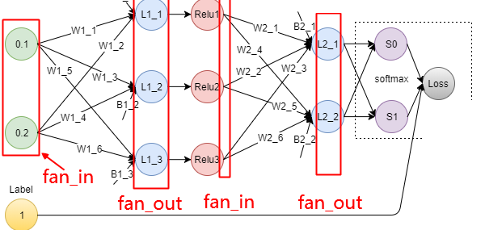

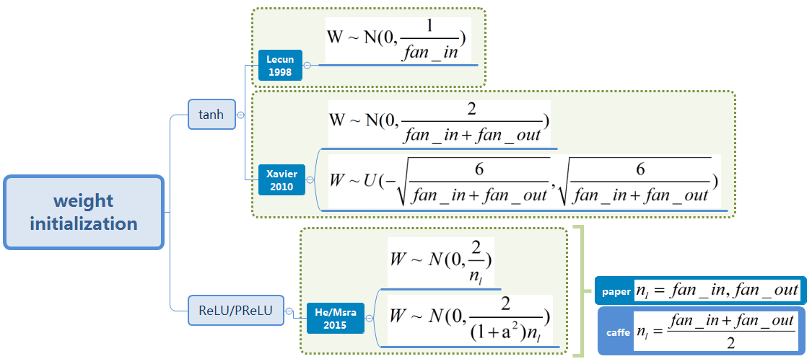
Some simple choices
Gaussian distribution N(0, sigma)
Random distribution [-r, r]
Rules
The variance of the input layer and the output layer neurons should be similar, i.e., all layers should have similar variation
Efficient BackProp
Xavier-2010-Understanding the difficulty of training deep feedforward neural networks
Understand Kaiming Initialization and Implementation Detail in PyTorch

Slide 35
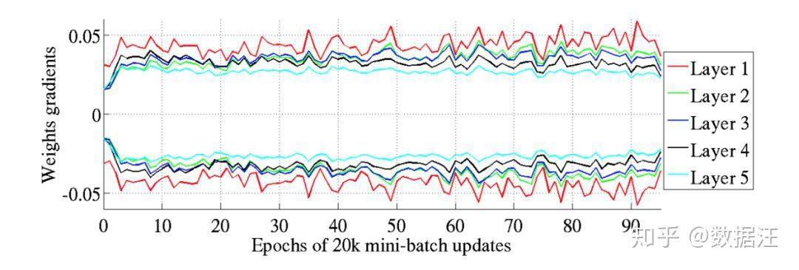
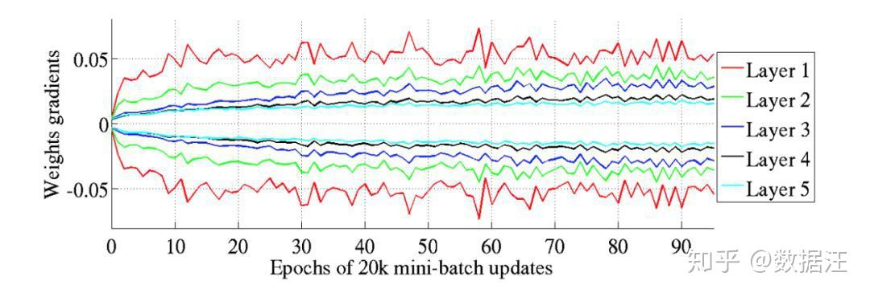
Xavier-2010
Standard Gaussian

Slide 36
Practical Considerations
Data normalization
Scaling inputs (important not just for neural networks)
Large differences in scale of different features due to the choice of units is compensated by normalizing them to be in the same range, [0,1] or [-1,1];
without normalization, error will hardly depend on feature with very small values
Standardization: Shift the inputs to have zero mean and unit variance
Target Values
One-of-C representation for the target vector (C is no. of classes). Better to use +1 and –1 that lie well within the range of sigmoid function saturation values (+1.716, -1.716)
Higher values (e.g. 1.716, saturation point of a sigmoid) may require the weights to go to infinity to minimize the error

Slide 37
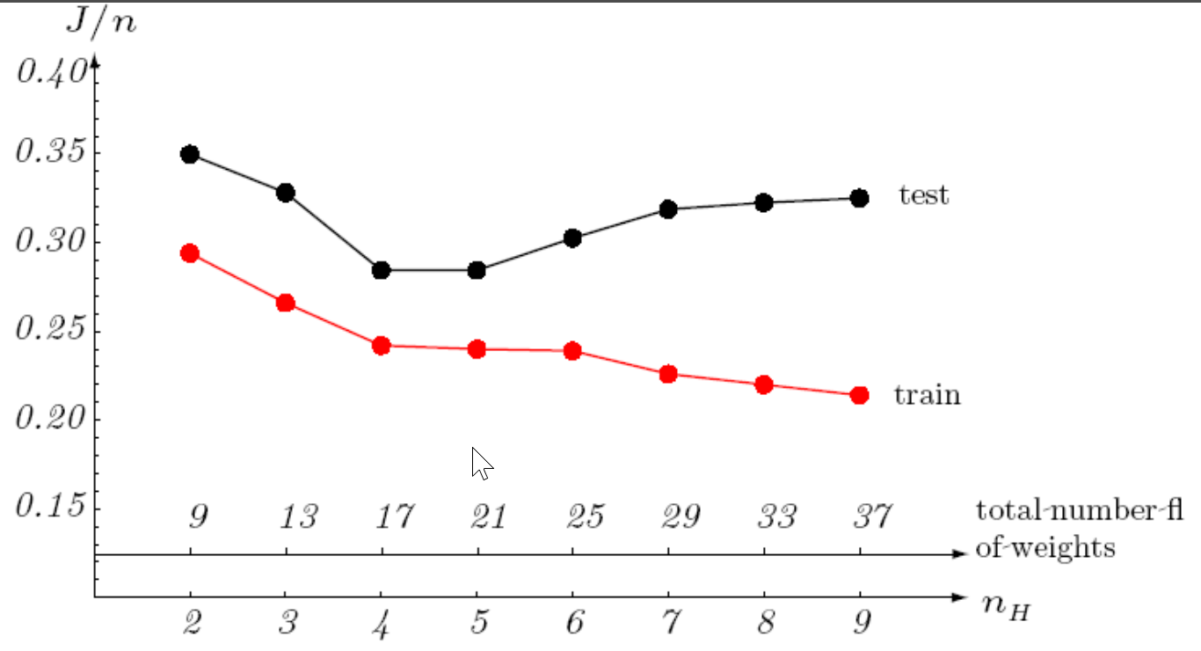
Practical Considerations
Number of Hidden units
Governs the expressive power of the network
The easier the task, the fewer the nodes needed
Rule of thumb: total no. of weights must be less than the number of training examples (preferably 10 times less);
A more principled method is to adjust the network complexity in response to training data;
e.g. start with a “large” no. of hidden units and “decay”, prune, or eliminate weights

Slide 38
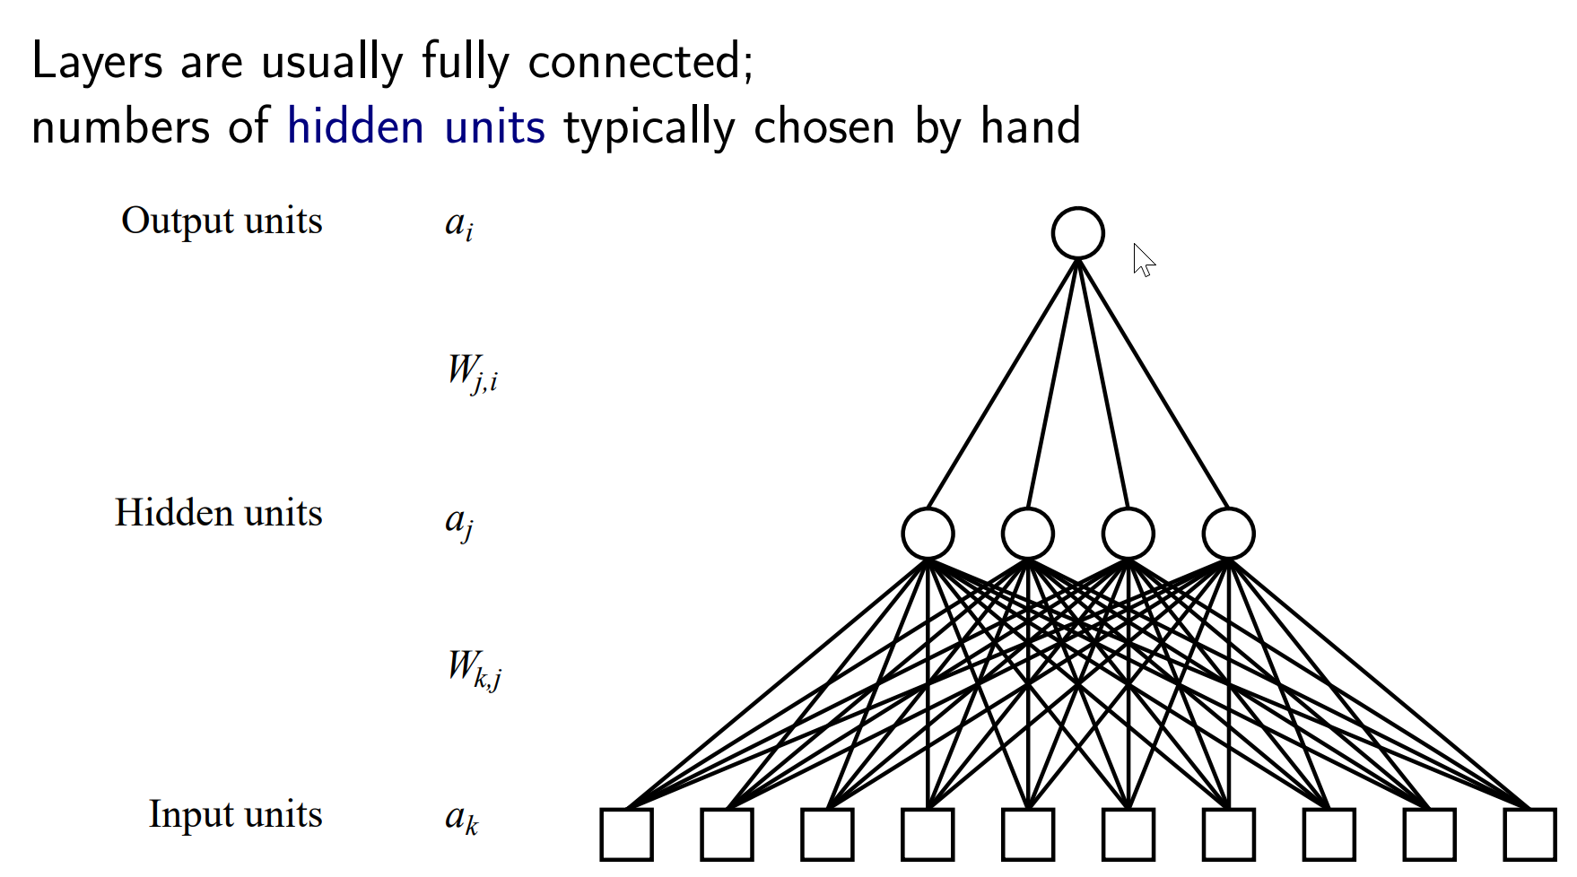
Feature Interaction
Can we enforce feature interaction

